Slide 1





Automated Failure Detection & Alert Notification for Containerized Applications
DevOps IA-2 Case Study, Tool: Prometheus and Alertmanager
Yashasvi Gupta · 16010123341
Shweta Karandikar · 16010123329
Aditi Agrawal · 16010123018
Notes:
Good morning. We're Yashasvi, Shweta and Aditi. Our IA-2 case study is on Prometheus and Alertmanager: how they catch failures in containerized applications on their own and tell the right people. We'll explain why we chose them and how they work, show them catching real failures live, and judge them with numbers we measured.

Slide 2






Containers fail quietly
A process hangs
docker ps still says Up, but users time out
Our goal
A dependency dies
  Detect each of these automatically
  Notify the right person within about a minute
  One message per incident, not a flood
  Say when it is fixed
  Measure how well the tool does it
the web service keeps answering, with errors
Memory leaks
until the kernel's OOM killer stops the process
Our setting: a hospital's ordering system. If it fails at 2 am and nobody is told, a ward waits for insulin that never comes.
CPU hits its limit
the container is throttled and everything slows
It crashes and restarts
the restart hides the problem
2
Notes:
Picture City General Hospital. Its wards order insulin, saline and other supplies from the pharmacy through a small service called OrderFlow, all night. If OrderFlow fails at 2 am and nobody is told, the nurse's order just disappears, and the problem is found at the 8 am shift change. That is our scenario. Containers make failure quiet: a container can show as Up while the app inside has hung, lost its database, is leaking memory, is starved of CPU, or has crashed and been restarted. Hospitals also know the opposite problem, alarm fatigue: when alarms go off too often, people stop listening. So our goal was to detect all of these automatically, notify the right person within about a minute, send one message per incident instead of a flood, say when it is fixed, and measure how well the tool does this.

Slide 3






Why Prometheus and Alertmanager
Built for containers
PromQL
Noise control
CNCF graduated; discovers Docker and Kubernetes targets
rates, ratios and percentiles in one query language
grouping, routing, inhibition and silences
Configuration as code
Free and open source
Light
YAML in Git, unit-tested with promtool and amtool
Apache 2.0, self-hosted, no per-host pricing
the whole monitoring side used about 180 MiB
Also considered: Nagios, Zabbix, Datadog, Grafana Alerting, AWS CloudWatch (compared later)
3
Notes:
We needed something that works with short-lived containers, can express conditions like more than ten percent of requests failing for thirty seconds, can route and de-duplicate notifications, keeps its configuration in Git, and is free. Prometheus is a CNCF graduated project built for containers, PromQL handles rates and percentiles, Alertmanager adds grouping, routing, inhibition and silences, everything is YAML we can unit-test, and it is light. We also looked at Nagios, Zabbix, Datadog, Grafana Alerting and CloudWatch, which we compare later.

Slide 4
How Prometheus works
Targets
Scrape
Store
Evaluate
apps and exporters expose /metrics
Prometheus pulls every 5 s; a failed pull sets up = 0
time series with labels in its own database (TSDB)
rules run every 5 s: pending, then firing
Metric types we use
Counter
Gauge
Histogram
only goes up; read with rate()
goes up and down
counts values in buckets; gives p95
http_requests_total
app_dependency_up
http_request_duration_seconds
4
Notes:
Prometheus pulls. Every five seconds it requests the /metrics page of each target and stores the numbers, with labels, in its own time-series database. If a target does not answer, Prometheus records up equals zero, so a failed pull is itself a signal. Every five seconds it also evaluates rules. When a rule's condition is true the alert becomes pending, and once it has stayed true for the rule's for duration it fires. We use three metric types: counters such as total requests, which we read through rate; gauges such as memory; and histograms for latency, which give us the 95th percentile.

Slide 5


How Alertmanager handles alerts
Inhibit
Silence
Group
Route
Notify
drop symptoms of a firing cause
mute known alerts during maintenance
bundle related alerts into one message
pick receivers by severity
send, repeat, then send RESOLVED
Our routes
Critical
Warning
Watchdog
email to on-call + #ops-chat
#ops-chat only
heartbeat endpoint, about once a minute
5
Notes:
Prometheus decides that something is wrong; Alertmanager decides who hears about it. Each alert passes through five steps. Inhibition drops alerts that a firing cause already explains. Silences mute known alerts during maintenance. Grouping bundles related alerts into one message. Routing picks the receivers. Notification sends the message, repeats it if needed, and sends a resolved message at the end. Our routes: critical alerts go by email to on-call and to the team chat, warnings only to the chat, and an always-firing Watchdog alert goes to a heartbeat endpoint so we know the alerting itself works.

Slide 6
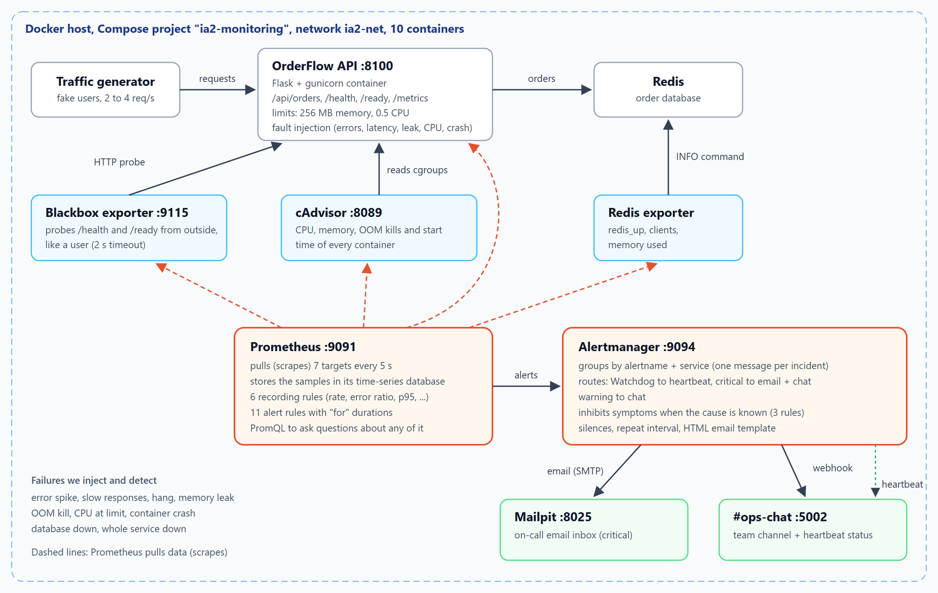
Our setup: ten containers, one command
10
containers via docker compose
7
scrape targets, every 5 s
6 + 11
recording + alert rules
3
receivers: email, chat, heartbeat
6
Notes:
This is what we built. OrderFlow, the hospital's ordering service, runs in a container limited to 256 MB of memory and half a CPU, backed by a Redis database, with a traffic generator playing the wards that place orders. Prometheus scrapes seven targets every five seconds: the app's own metrics, a blackbox exporter that probes the app from outside, cAdvisor for container CPU and memory, and a Redis exporter. Alertmanager sends critical alerts to an email inbox, Mailpit, and everything to our ops chat channel. The whole stack starts with one docker compose command.

Slide 7


Three angles of monitoring
White-box
Black-box
Container-level
the app reports on itself through /metrics
the blackbox exporter calls /health and /ready like a user
cAdvisor reads every container's cgroups
Sees
Sees
Sees
request counts, latency histogram, Redis status
probe_success, probe duration
memory vs limit, CPU throttling, OOM kills, restarts
Catches
Catches
Catches
error spikes and slowness
a hang: /metrics still answers (up = 1) but users time out
leaks, OOM kills, CPU starvation, crashes
7
Notes:
We monitor from three angles. White-box: the app exposes its own request counts, latency and Redis status on /metrics, which catches error spikes and slowness. Black-box: the blackbox exporter calls /health and /ready the way a user would. This matters for a hang, because the metrics page still answers, so up stays one, but users time out, and only the probe notices. Container-level: cAdvisor reads each container's statistics from the kernel, so it sees memory against the limit, CPU throttling, out-of-memory kills and restarts, even for containers with no metrics of their own.

Slide 8
Eleven alert rules
Alert | Fires when | Severity
ServiceDown | up == 0 for 30 s | critical
EndpointDown | black-box probe of /health fails for 40 s | critical
DependencyDown | Redis down, or its exporter unreachable, for 15 s | critical
HighErrorRate | more than 10% of requests return 5xx, for 30 s | critical
ContainerOOMKilled | the kernel killed a process for using too much memory | critical
ServiceNotReady | /ready probe fails for 45 s | warning
HighLatencyP95 | p95 latency above 500 ms for 1 min | warning
ContainerMemoryNearLimit | memory above 80% of the container limit for 15 s | warning
ContainerCPUThrottled | throttled in more than half of CPU periods for 30 s | warning
ContainerRestarted | a container started again in the last 5 min | warning
Watchdog | always firing: proves the alert path works | none
8
Notes:
These are our eleven alert rules. Five are critical and page on-call by email: the service is down, the health check fails from outside, the Redis database is down, more than ten percent of requests fail, or a process is killed for running out of memory. Five are warnings that go to the chat: not ready, slow, memory near the limit, CPU throttled, or a container restarted. The Watchdog always fires on purpose. Each rule waits for a for duration before firing, so short blips do not wake anyone up, and every rule has a unit test.

Slide 9
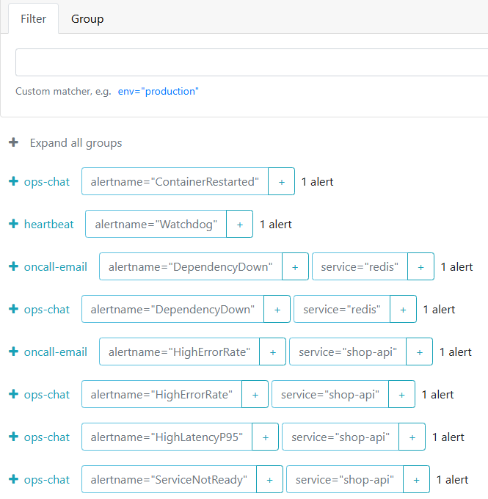
One message per incident
Order database (Redis) stops:
DependencyDown
1
message
HighErrorRate
ServiceNotReady
HighLatencyP95
  4 alerts raised in Prometheus (3 firing, 1 pending); on-call got 1 email about the cause.
  Inhibition: a firing cause hides its symptoms.
  Grouping: related alerts share one message.
  Causes wait less than symptoms (15 s vs 30 s), so the cause is already firing when symptoms arrive.
Alertmanager during the outage, with Inhibited ticked: the symptoms are held back
9
Notes:
This is the part that makes alerting usable. Back at the hospital, the pharmacy's order database, Redis, goes down. Prometheus raised four alerts: the database being down, plus three symptoms in the web service, one of them still pending. On-call received exactly one email, about the database. Alertmanager's inhibition rule says that when DependencyDown is firing, the error rate, latency and readiness alerts for the same app are only symptoms, so it holds them back. For that to work, the cause must fire first, so the cause rule waits fifteen seconds and the symptoms thirty.

Slide 10
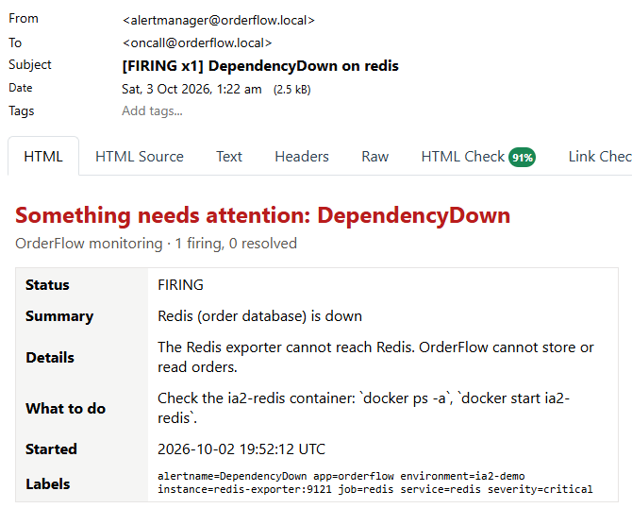
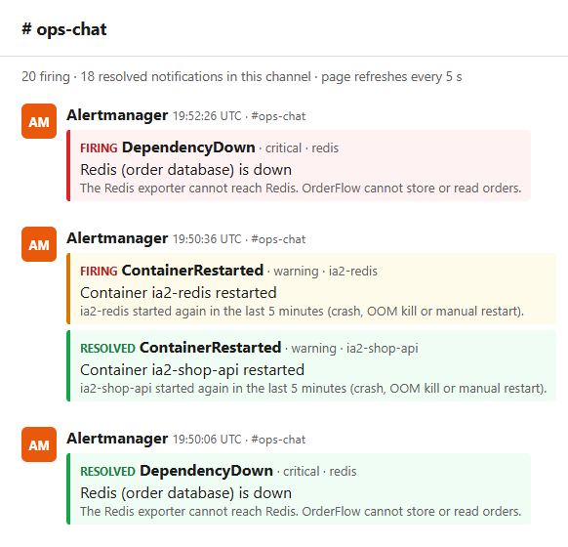
What on-call and the team see
On-call email
Subject and HTML body come from our template, including a "what to do" line.
#ops-chat
Every warning and critical alert appears here, first as FIRING, then as RESOLVED.
10
Notes:
This is what people actually receive. At 2 am, this email is what reaches the on-call engineer, so it has to say what is wrong and what to check first. On the left, the on-call email for the database outage. The subject line and the HTML body come from our own notification template, with a summary, details, a what-to-do line and the labels. On the right, the team chat, where every warning and critical alert appears, followed by a resolved message when it clears. The chat page also shows a heartbeat badge: if it ever turns red, the alerting pipeline itself is broken.

Slide 11
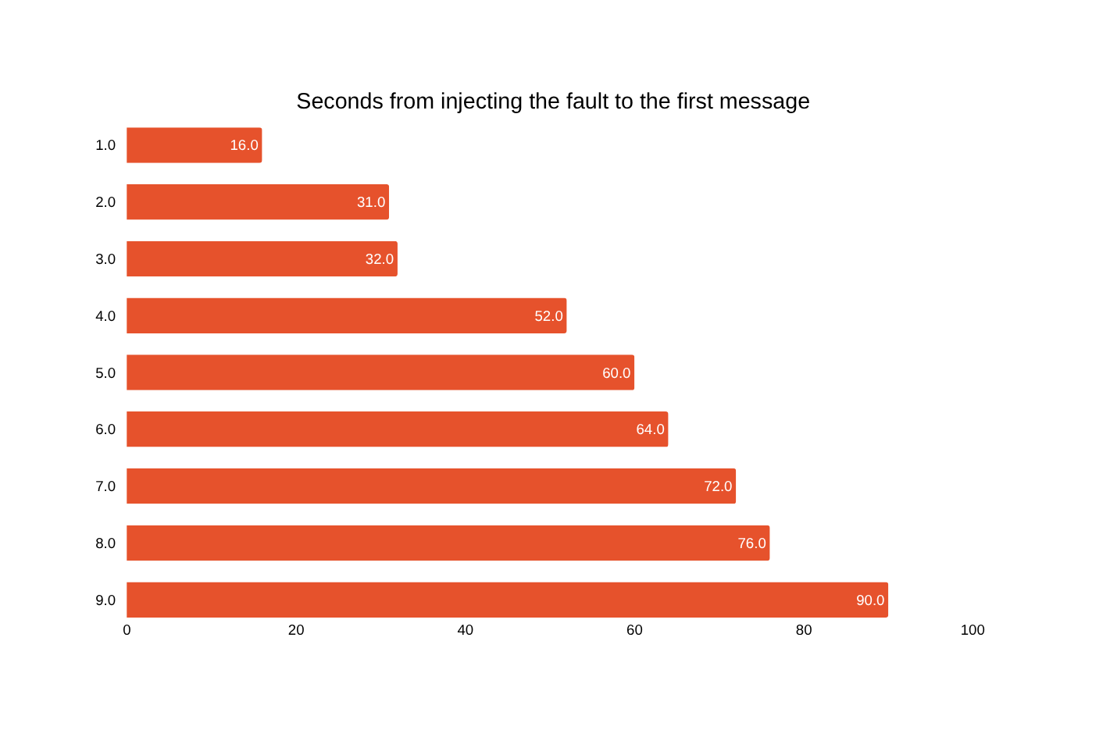
Every failure detected within 90 seconds
9 / 9
failures detected
60 s
median time to first message
0
pages for a 10-second blip
4 → 1
alerts → messages, database outage
11
Notes:
We wrote a script that injects each failure and times the notification. All nine failures were detected. The first message arrived between sixteen and ninety seconds after the fault, with a median of sixty seconds, and critical emails arrived in twenty-six to fifty-nine seconds. The time is the scrape interval, plus the time for the query to cross its threshold, plus the for duration, plus Alertmanager's group wait, and it is deliberate. A ten-second outage sent no page at all, and during the database outage four alerts became one message. For the hospital, a broken ordering system is noticed within about a minute, not at the 8 am shift change.

Slide 12
How it compares
 | Prometheus + Alertmanager | Nagios Core | Zabbix | Datadog | CloudWatch
Cost | free, open source | free; XI is paid | free, open source | paid per host | pay per metric and alarm
How data arrives | pull over HTTP | plugin checks | agents, SNMP | agent to SaaS | AWS services, agent
Fit for containers | native discovery, cAdvisor | weak: static hosts | Docker template | strong | ECS and EKS
Alert noise control | group, inhibit, silence, route | escalations | actions, escalations | notification rules | alarms to SNS
Config as code | YAML + unit tests | text files | mostly web UI | UI, Terraform | CloudFormation
Logs and traces | no (add Loki, Tempo) | no | limited | yes | yes
Summarised from each product's public documentation, October 2026. Grafana Alerting builds on data sources such as Prometheus.
12
Notes:
Compared with the alternatives: Nagios comes from a world of fixed servers and fits short-lived containers poorly. Zabbix is powerful but configured mostly through its web interface. Datadog and CloudWatch are paid services; Datadog is the easiest to start and covers logs and traces, but costs money per host and ties you to a vendor. Prometheus with Alertmanager is free, built for containers, has the best noise control of the group, and keeps its configuration in Git with unit tests. Its gap is that it handles metrics only, so logs and traces need tools like Loki and Tempo.

Slide 13

Strengths, limits and lessons
Strengths
Limitations
Bugs our tests found
  One query language for graphs and alerts
  Alerts are code: reviewed, tested in CI
  Grouping and inhibition cut the noise
  Small footprint (about 180 MiB)
  Metrics only: no logs or traces
  One server is a single point of failure
  Local storage, not long-term
  PromQL takes time to learn
  CPU alert never fired: the usage ratio was too jumpy, so we alert on throttling instead
  Database alert flapped: the exporter timed out, so we added a 1 s timeout and alert on up == 0 too
13
Notes:
Strengths: one query language for graphs and alerts, alerts that are code and tested in CI, grouping and inhibition that cut the noise, and a small footprint. Limitations: metrics only, a single server is a single point of failure unless you run two, local storage is not long-term, and PromQL takes time to learn. Our own measurement run also found two real bugs. The first CPU alert never fired, because the usage ratio jumped up and down, so we switched to the throttling ratio. And the database alert flapped, because the Redis exporter took longer than Prometheus's scrape timeout, so we gave it a one-second timeout and made the rule fire when the exporter itself cannot be reached.

Slide 14

Tested like code: the CI pipeline
git push
Unit tests
Rule tests
Start the stack
Break it
GitHub Actions starts on every push to main
20 app tests, 6 receiver tests, flake8
8 promtool cases, amtool routing checks
all 10 containers, wait for targets and heartbeat
inject 50% errors; pass only if chat AND email get the alert
Why this matters: a broken alert rule is as bad as broken code, because nobody hears about the next outage. Every change to a rule, a route or a template is tested before it can reach main, including one test proving a 10-second blip does not page anyone.
14
Notes:
We treated alerting like code. On every push, GitHub Actions runs the app and receiver tests. Then it runs promtool unit tests for every alert rule and amtool checks for the routing. After that it starts all ten containers, waits for every target and the heartbeat, and injects fifty percent errors. The run passes only if the alert actually reaches both the chat and the email inbox. A broken alert rule is as dangerous as broken code, because nobody hears about the next outage.

Slide 15

Conclusion
Detects
all 9 failure types, from a crash to a slow memory leak, in 16 to 90 seconds
Thank you
Questions?
Then the live demonstration.
Filters
one message per incident; a 10-second blip pages nobody
Closes the loop
resolved messages, a heartbeat, and tests in CI for every rule
Notes:
Prometheus and Alertmanager detected all nine kinds of failure we injected, within sixteen to ninety seconds. They turned each incident into one clear message on the right channel, ignored a harmless ten-second blip, and followed every alert with a resolved message. The heartbeat and the CI tests make sure the alerting itself keeps working. Every failure found in about a minute, one clear page per problem, and no false alarms. The ICU gets its insulin. Thank you. We will now show it live.

